Slide 1
Static testing
Code walkthrough
Desk Check

Slide 2
STATIC TESTING
Verification Process
Review and Evaluation
No Execution

Slide 3
1. Self Review 2. Code inspection 3. code walkthrough 4. desk check
Methods Of Static Testing

Slide 4
Code Walkthrough
Peer review
Led by Programmer
Participants :
Author, Scribe, Reviewer
Process
Step By Step Explanation Of Code
Queries And Suggestions
Minutes Of Meeting
Purpose
Outcomes
Successful
Corrective Action Needed, No Further Review Needed
Corrective Action Needed, Review Needed
Example

Slide 5
Desk Check
Verify the portions of the code
Done manually before compiling and executing the code
No process for effectiveness of checking
Effective for correcting “obvious” coding errors
Cannot detect errors due to incorrect understanding of requirements

Slide 6
Process
Understand the given problem
Specify a high level solution
Develop the outline
Develop the algorithm
Test the algorithm

Slide 7
Problem :
Calculate the discounted price of an item purchased by a consumer.
Solution :
The problem requires calculation of price of an item. So the variables used will be - input_price, discount_percent, discount, discount_price.
Prepare Outline
Algorithm :
calculate_discountPrice()
declare input_price, discount_percent
discount = input_price * discount_percent/100
discount_price = input_price - discount
Display discount_price
stop
Test Data
This step is to check the output of the actual code.
Inputs : input_price, discount_percent output : discount_price
Input | Processing | Output
item_price | Calculating the discount rate | Actual discount value

Slide 8
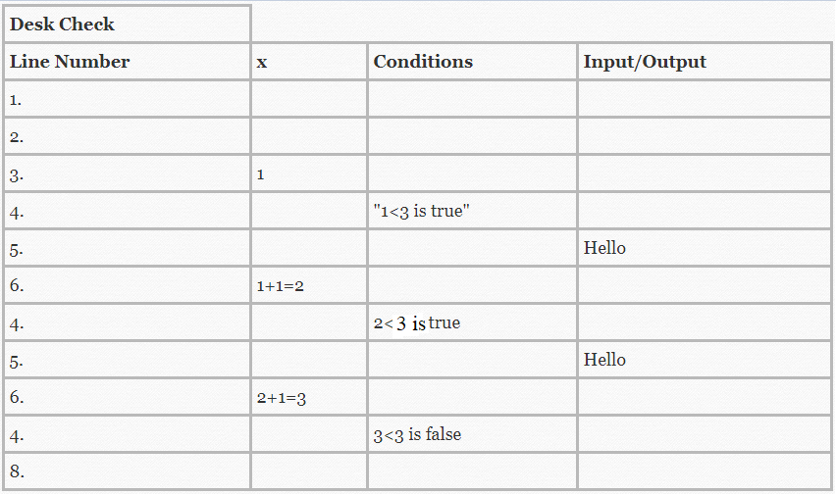
Consider the part of code
For(x=1; x<3; x++)
{
Print(“hello”)
}

